Slide 1
Visual Studio
Brandon Moe

Slide 2
Download Visual Studios
We will not use this for our class, but we will use it during the build season.
The only ones that currently have access to this code is Steve and myself
If you would like to get a copy of any of the code listed on the next slide, contact us and we will get it to you.

Slide 3
Code currently uploaded
2017 Competition bot command and control
2016 Competition bot command and control
2016 Competition bot standard format code
Arduino Lights 2017
Arduino Lights 2016
2017 Dashboard
2016 Dashboard

Slide 4
Code to be uploaded
T-Shirt Cannon
2017 Candy Robot #1
2017 Candy Robot #2
Little Red

Slide 5
Visual Studio 101

Slide 6
Commenting
GIVE THINGS MEANINGFUL NAMES!!!!!!!!!!!!!!!!!!!!!!!!!!!!!!!!
“Fixed Bugs” just doesn’t pay the bills
“Fixed bugs in shooter” better but still not great
“Fixed bug in shooter motor that caused wheel to break when turning off instead of coast” now that is a comment
Type a paragraph if you have to!
Moto to live by.
“If Todd looks at this could he understand it by how I have commented and labeled things?”
If he can’t then it isn’t meaningful.

Slide 7
What is it?
It is a private server to host code.
We use it to upload all of our LabVIEW projects
Server is prceptconsulting.visualstudio.com/PreceptConsulting
We refer to this as “Source Control”

Slide 8
Why do we like this?
Everyone has access to code
Your code is backed up
If you really mess up the code, you can go back to a previous save.

Slide 9
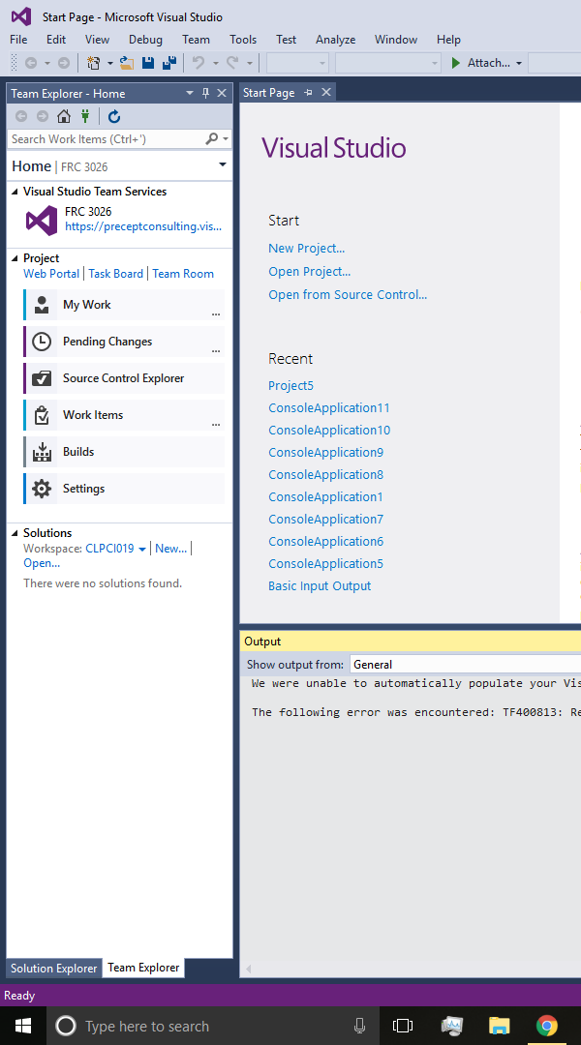
Navigating
Most of the time you will go under “Source Control Explorer”

Slide 10
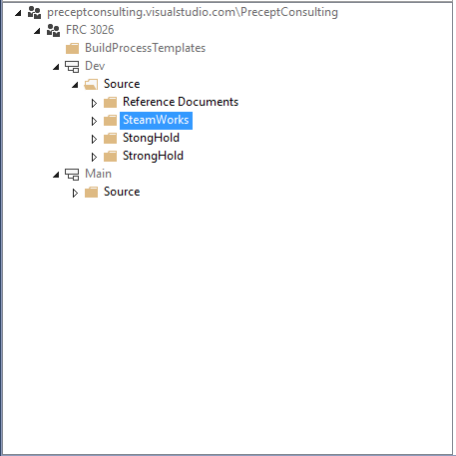
Source Control Explorer
You can view all of the code on our server
DEV
Used while the code is being developed
You have rights to do things here
MAIN
Used for final code copies
You do not have rights to modify this

Slide 11
DEV
Organized by game title for our code
3026 Custom VI’s
Has all of our custom VI
Reference Documents
Has other teams code as reference

Slide 12
Getting Latest Version
Before you check out any code always get the latest version
It is very important that you have the most recent version of code

Slide 13
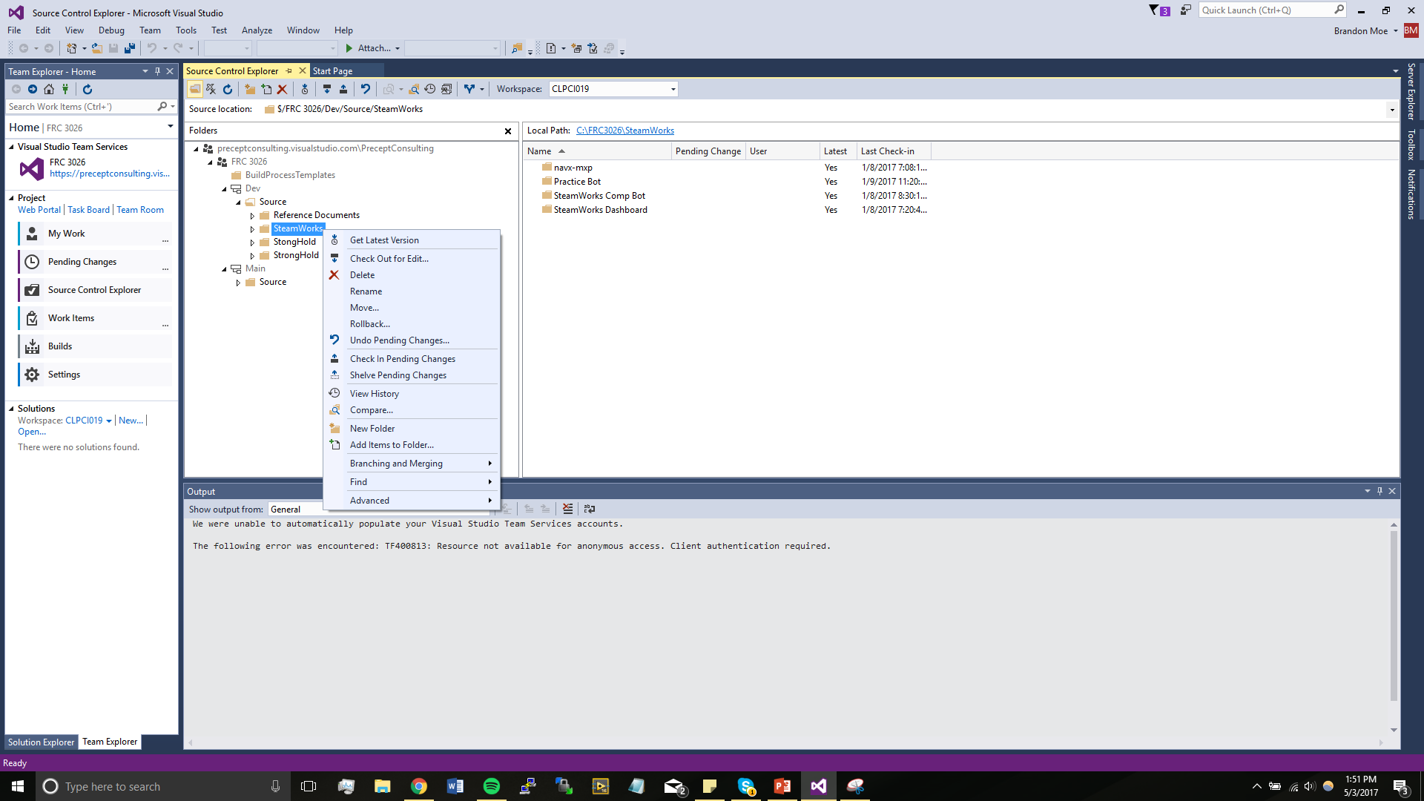
Get latest version method 1
Right click on a folder and click “get latest version”

Slide 14
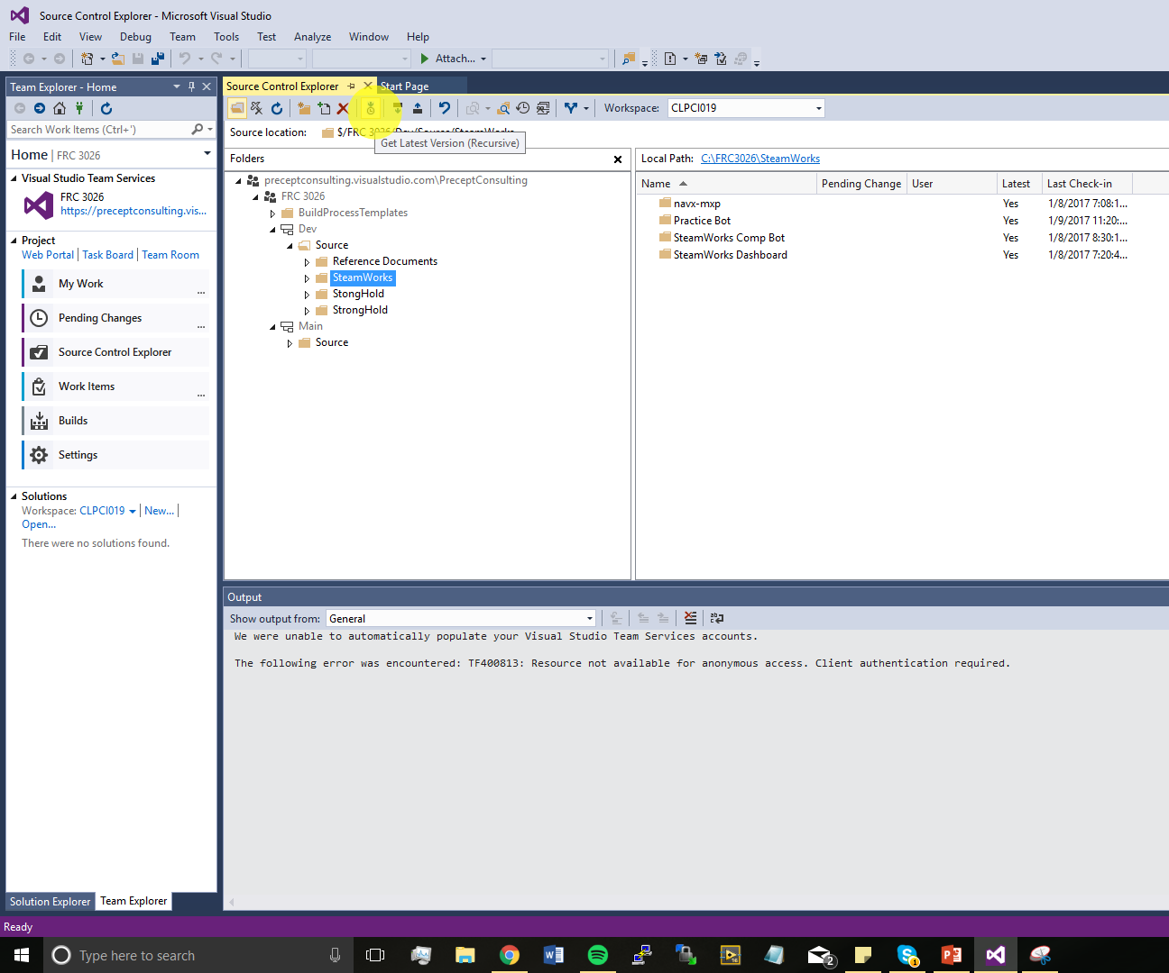
Get Latest Version Method 2
Click on the get latest version on the top navigation
It will get latest version for current folder

Slide 15
Checking Out code
Before modify code you need to check it out for edit
Make sure you have the latest version before you check code out

Slide 16
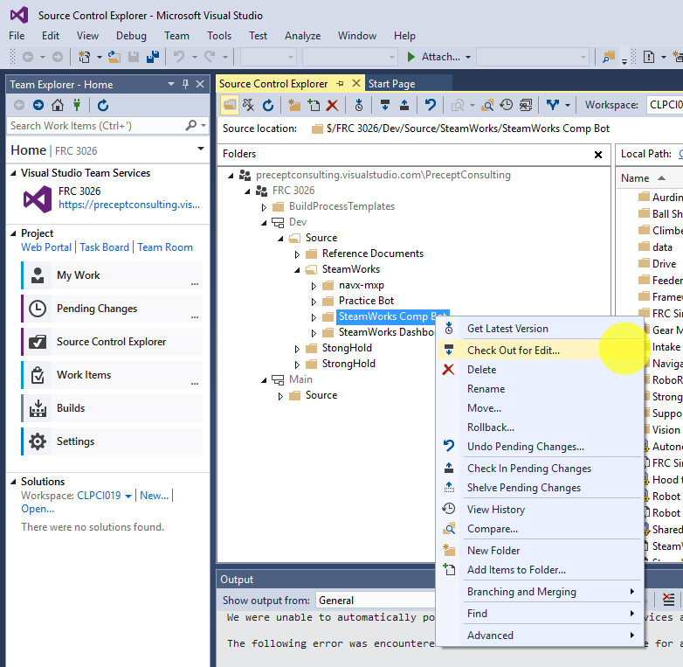
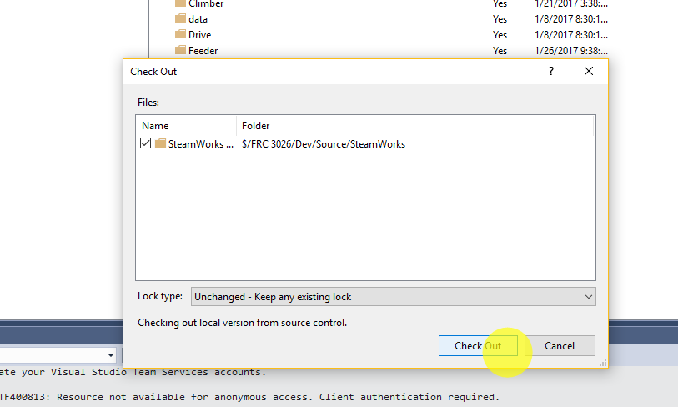
How to check out code
Right Click on the folder and click “Check out for edit”

Slide 17
Once you have the code checked out
You can make any changes to the portion of the code you have checked out.
Make the necessary changes to the code for the task you are doing.

Slide 18
Once you are done
You will need to check in the code.

Slide 19
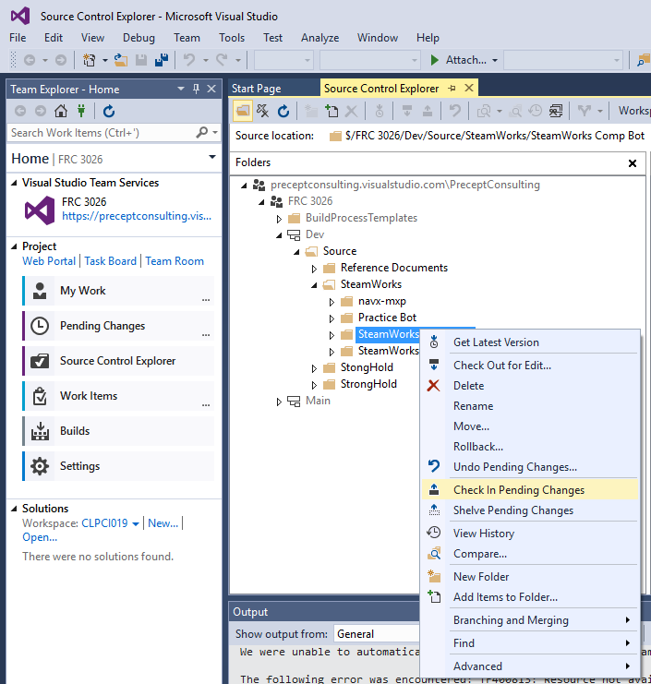
Step 1
Check in code.

Slide 20
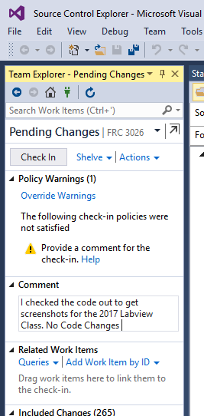
Step 2
Explain what you did while you had the code checked out. If I cant tell EXACTLY what you did by the comment, you didn’t comment it correctly

Slide 21
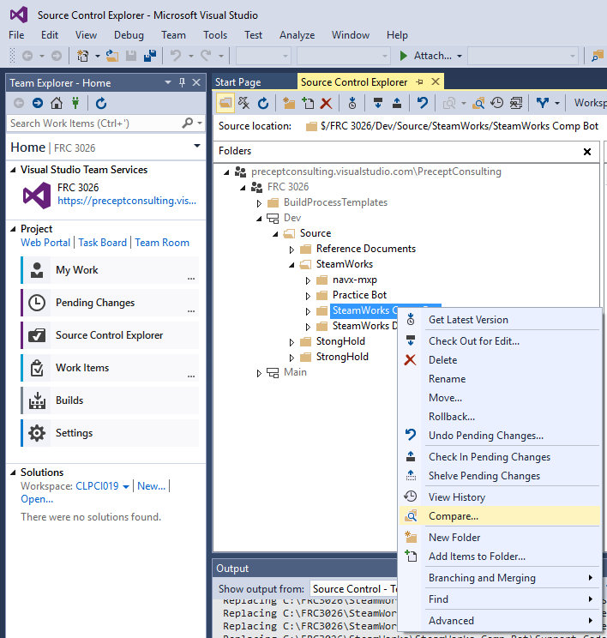
Step 3
Compare

Slide 22
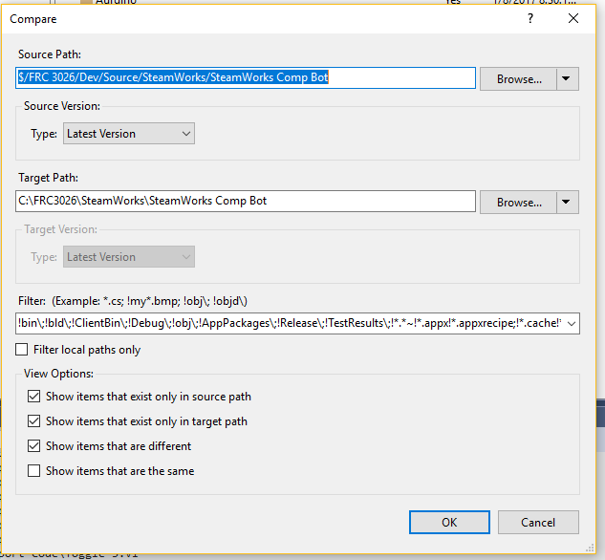

Slide 23
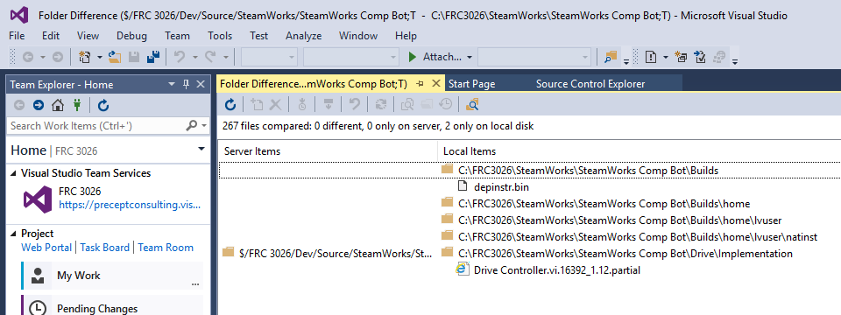
Check differences
The Bin file should be the only thing on this list!

Slide 24
Other Things You Can Do

Slide 25
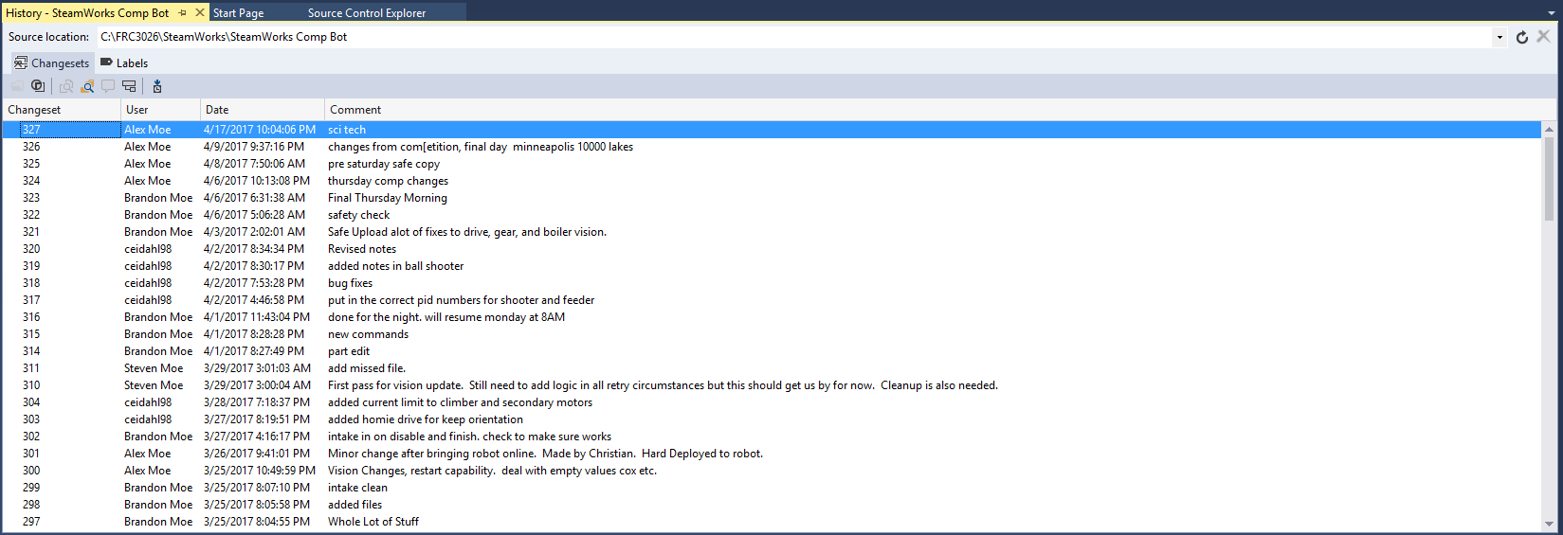
View History
View the history of code changes (right click on folder and click view History).

Slide 26
FYI
All of these comments suck except for Steve's.
The worst comment you will ever see. This was done by me ☹
Steve's Comment

Slide 27
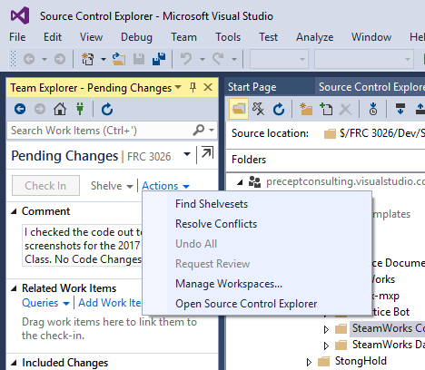
Undo Pending Changes
If you screw up to the point of no return (It happens don’t worry) you can undo the pending changes.

Slide 28
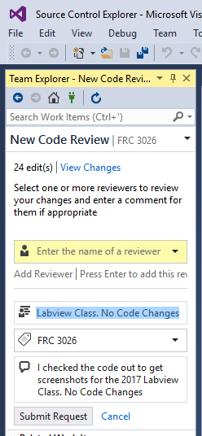
Request Code Review
If you are not 100% on your code change. You can ask for a code review from either Steve, Harry, or I.
Enter Our Names Here. Remember to give a meaningful comment or we will not know what to look for.

Slide 29
Rollback Change Set
If a code gets uploaded and it doesn’t work. You can go back to an older version of code.
View the history of the code and get a change set number.

Slide 30
